Slide 1
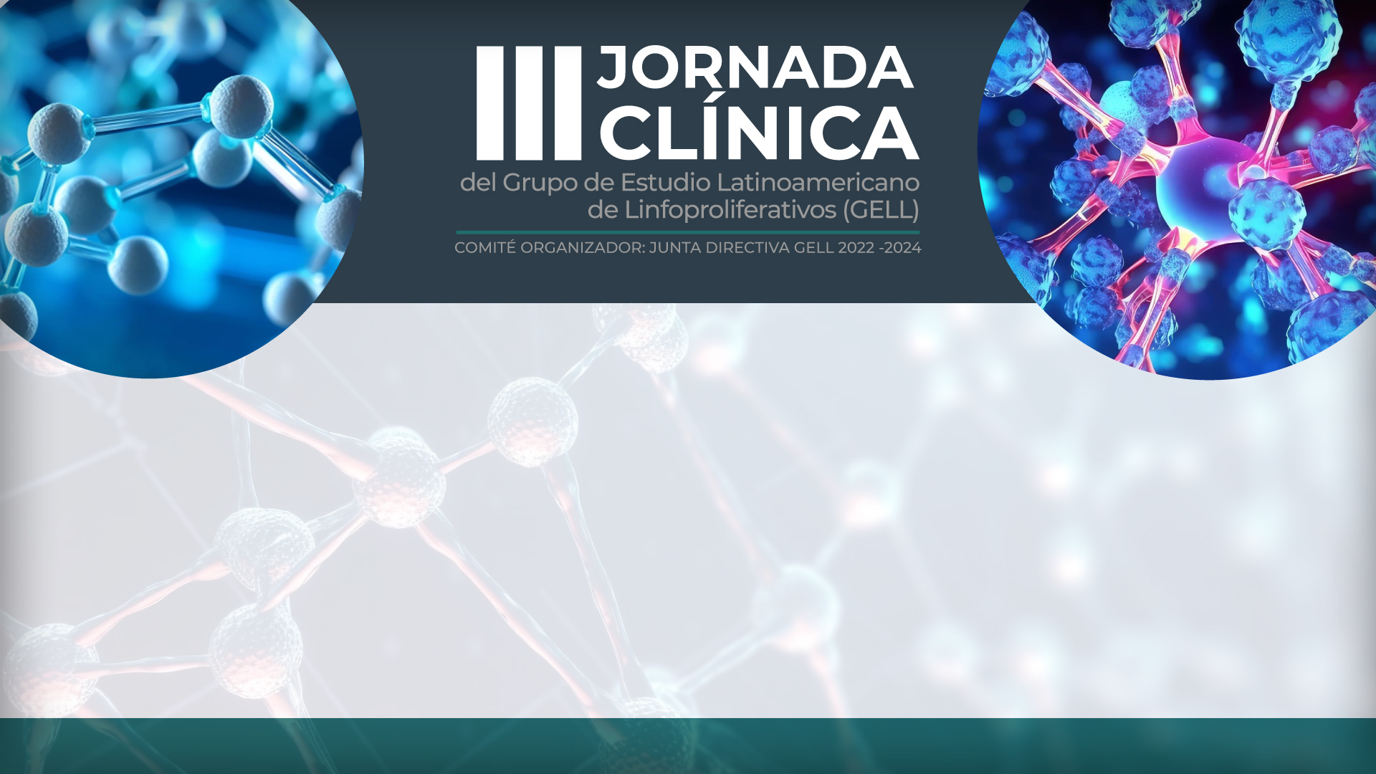

MANEJO ACTUAL DEL LDCBG: Necesidades Insatisfechas actuales

Slide 2

La presente charla está patrocinada por laboratorios AbbVie, el contenido no refleja necesariamente la posición de AbbVie
Las recomendaciones y contenido expresado en esta presentación son propias del autor y están basadas en su experiencia profesional, pueden contener información de moléculas no aprobada regulatoriamente en algunos países/off label, en el marco de una actividad académica médica. Las referencias bibliográficas incluidas en la presentación fueron revisadas y son responsabilidad del autor.

Slide 3
CONFLICTO DE INTERESES
Expositor/Investigación: Janssen, Astrazeneca, MSD, Amgen, Bristol, Sanofi, Roche, Axopharma, Novartis, Recordati Rare Diseases, Astrazeneca, Farma de Colombia, Takeda/Shire, Abbott, Biopas, Tecnofarma, MSN, Apellis, PTC Therapeutics, Human Bioscience, Pfizer, Alexion, ACMI, ACHO,GELL, ArgenX, Apellis, ICON.
Material exclusivo para el profesional de la salud, prohibida su distribución al publico en general.

Slide 4
R-CHOP has been SoC in 1L DLBCL for nearly two decades GELA LNH98-5: Phase 3 study of R-CHOP vs CHOP in patients aged 60–80 years (N=399)
Overall survival with R-CHOP vs CHOP in untreated DLBCL
1.0
0.8
R-CHOP
0.6
OS (probability)
CHOP
0.4
Endpoint | R-CHOP (n=202) | CHOP (n=197)
OS, n with event (%) | 59 (29) | 81 (41)
Median survival, mo | NR | NR
2-year survival, % (95% CI) | 70 (63–77) | 57 (50–64)
0.2
Relative risk of death: RR=0.64; 95% CI=0.45–0.89; P=0.007
Median follow-up: 24 months
0.0
0
0.5
1.0
1.5
2.0
2.5
3.0
Years after randomization
Most common AEs in both arms were fever, infection, and mucositis
Grade 3 and 4 AEs were similar between arms and consistent with effects of CHOP chemotherapy seen in previous studies

Slide 5
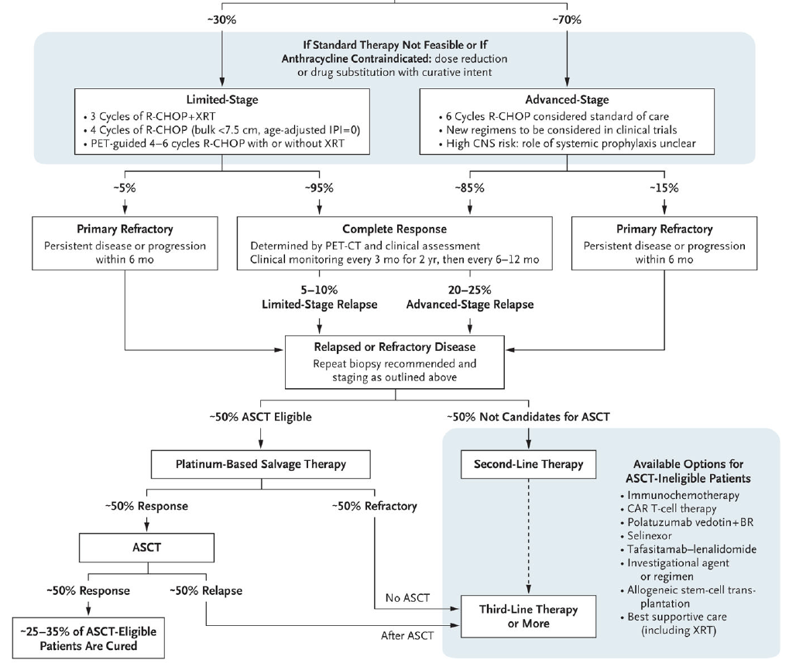
Current management of DLBCL Few patients who progress on 1L therapy are cured with ASCT
Outcomes of patients with DLBCL
1.00
Patients failing first-line therapy
0.75
Probability of survival
0.50
Very few patients who progressed are cured
0.25
Time to progression
Progression-free survival
Overall survival
0.00
0
1
2
3
4
5
6
7
8
9
10
Time (years)
Efficacy of available therapy at progression

Slide 6
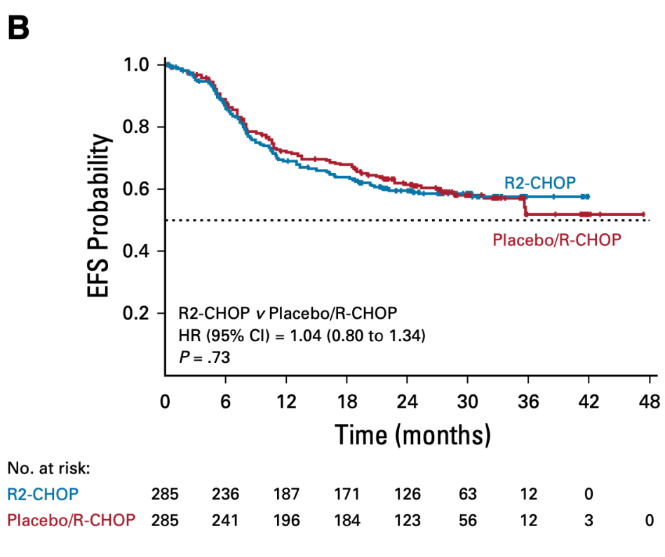
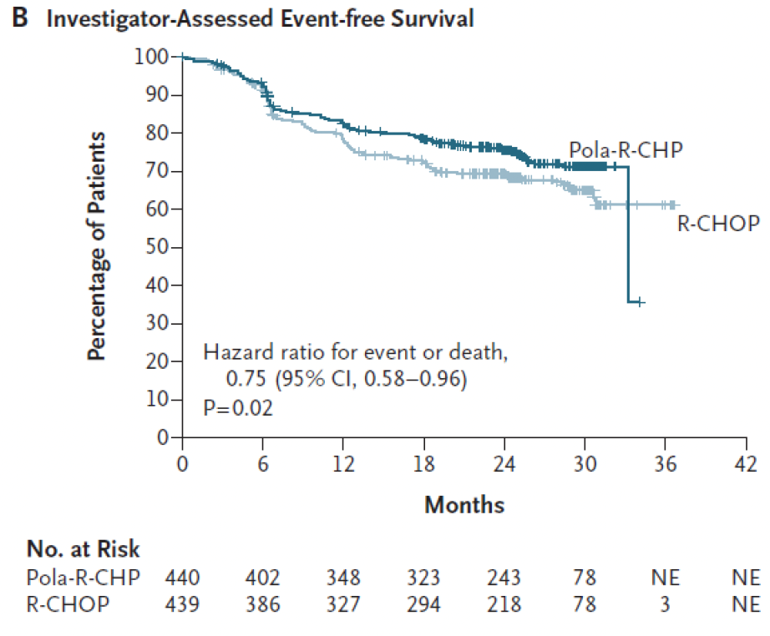
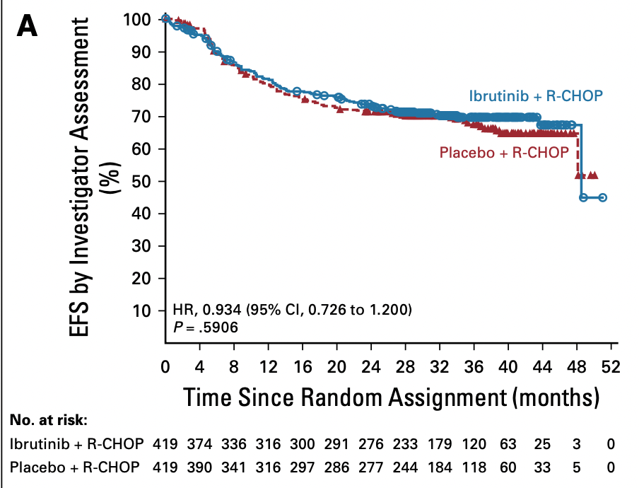
R-CHOP: 3 Decades Standard for 1st line DLBCL
PHOENIX
ROBUST
POLARIX
Younes et al, JCO, 2019
Nowakowski et al, JCO, 2021
Tilly et al, NEJM, 2021

Slide 7
How could Pola-R-CHP approval affect 1L treatment decisions? POLARIX: Pola-R-CHP vs standard R-CHOP in previously untreated DLBCL (N=879)
Investigator-assessed progression-free survival
100
90
80
Pola-R-CHP (n=440)
70
60
R-CHOP (n=439)
Patients (%)
50
40
30
20
HR for progression, relapse, or death: HR=0.73 (95% CI=0.57–0.95; P=0.02)
Median follow-up: 28.2 months
10
0
0
6
12
18
24
30
36
42
Time (months)
At two years, Pola-R-CHP reduced risk of disease progression, relapse, or death by 27% vs R-CHOP
Efficacy benefits for Pola-R-CHP vs R-CHOP were also seen for EFS (HR=0.75; p=0.02) and DFS (HR=0.70)
Tilly H, et al. N Engl J Med 2022; 386:351–363

Slide 8
Pola-R-CHP well tolerated with consistent safety outcomes POLARIX: Pola-R-CHP vs standard R-CHOP in previously untreated DLBCL (N=879)
AEs occurring in ≥20% of patients | Pola-R-CHP (n=435) |  | R-CHOP (n=438)
AEs occurring in ≥20% of patients, n (%)* | Any grade | Grade 3–4 | Any grade | Grade 3–4
Peripheral neuropathy | 52.9% | 1.6% | 53.9% | 1.1%
Nausea | 41.6% | 1.1% | 36.8% | 0.5%
Neutropenia | 30.8% | 28.3% | 32.6% | 30.8%
Diarrhea | 30.8% | 3.9% | 20.1% | 1.8%
Anemia | 28.7% | 12% | 26% | 8.4%
Constipation | 28.7% | 1.1% | 29% | 0.2%
Fatigue | 25.7% | 0.9% | 26.5% | 2.5%
Alopecia | 24.4% | 0 | 24% | 0.2%
SAE rates with Pola-R-CHP and R-CHOP were 34.0% and 30.6%, respectively; rates of AEs that led to drug discontinuation were similar between treatment arms (Pola-R-CHP: 6.2% vs R-CHOP: 6.6%)

Slide 9
Pola-R-CHP reduced 2L therapy requirements vs R-CHOP POLARIX: Pola-R-CHP vs standard R-CHOP in previously untreated DLBCL (N=879)
Type of 2L treatment received according to 1L therapy in POLARIX
125
109
100
R-CHOP
Pola R-CHP
78
75
Patients (n)
53
50
39
25
25
16
12
10
7
5
8
3
4
5
0
Total number of patients with a 2L therapy
Chemotherapy
Immuno-chemotherapy
ASCT
Radiotherapy
Clinical trials
Other therapy
Type of 2L therapy received
Patients receiving Pola-R-CHP were 34% less likely to require 2L therapy than those receiving R-CHOP;
incidence of 2L therapy after Pola-R-CHP was reduced vs R-CHOP across most types of 2L treatment

Slide 10
Efficacy of Pola-R-CHP was maintained with longer follow up POLARIX: Pola-R-CHP vs standard R-CHOP in previously untreated DLBCL (N=879)
Investigator-assessed progression-free survival*¹
100
80
60
PFS (%)
40
Pola-R-CHP (N=440)
R-CHOP (N=439)
Censored
20
3-year PFS: 7.7%
HR 0.76 (95% CI: 0.60–0.97)
Median follow-up: 39.7 months
0
0
12
24
36
48
55
Time (months)
Pola-R-CHP continued to show a PFS benefit over R-CHOP at ~3 years^{1,2}
Overall survival remained similar between treatment arms at primary and follow-up analyses^{1,3}

Slide 11
Efficacy demonstrated in elderly and high-risk patients POLARIX: Pola-R-CHP vs standard R-CHOP in previously untreated DLBCL (N=879)
Subgroup analysis of investigator-assessed PFS (ITT population)
Baseline Risk Factors | Total N | Pola-R-CHP (N=440) |  | R-CHOP N=439) |  | Hazard Ratio | 95% Wald CI | Pola-R-CHP Better | R-CHOP Better
 |  | n | 2-year Rate | n | 2-year Rate
Age group ≤60 >60 | 271 608 | 140 300 | 74.1% 77.9% | 131 308 | 71.9% 69.5% | 0.9 0.7 | (0.6–1.5) (0.5–0.9)
Sex Male Female | 473 406 | 239 201 | 75.9% 77.7% | 234 205 | 65.9% 75.2% | 0.7 0.9 | (0.5–0.9) (0.6–1.4)
ECOG PS 0–1 2 | 737 141 | 374 66 | 78.4% 67.2% | 363 75 | 71.2% 65% | 0.8 0.8 | (0.6–1.0) (0.5 to 1.4)
IPI score IPI 2 IPI 3–5 | 334 545 | 167 273 | 79.3% 75.2% | 167 272 | 78.5% 65.1% | 1.0 0.7 | (0.6 to 1.6) (0.5 to 0.9)
Bulky disease Absent Present | 494 385 | 247 193 | 82.7% 69% | 247 192 | 70.7% 69.7% | 0.6 1.0 | (0.4 to 0.8) (0.7 to 1.5)
Ann Arbor stage I–II III IV | 99 232 548 | 47 124 269 | 89.1% 80.7% 72.6% | 52 108 279 | 85.5% 73.6% 66.1% | 0.6 0.8 0.8 | (0.2 to 1.8) (0.5 to 1.3) (0.6 to 1.1)
Baseline LDH ≤ULN >ULN | 300 575 | 146 291 | 78.9% 75.4% | 154 284 | 75.6% 67.2% | 0.8 0.7 | (0.5 to 1.3) (0.5 to 1.0)
No. of extranodal sites 0–1 ≥2 | 453 426 | 227 213 | 80.2% 73.0% | 226 213 | 74.5% 65.8% | 0.8 0.7 | (0.5 to 1.1) (0.5 to 1.0)
Cell-of-origin GCB ABC Unclassified Unknown | 352 221 95 211 | 184 102 44 110 | 75.1% 83.9% 73% 73.8% | 168 119 51 101 | 76.9% 58.8% 86.2% 64.3% | 1.0 0.4 1.9 0.7 | (0.7 to 1.5) (0.2 to 0.6) (0.8 to 4.5) (0.4 to 1.2)
Double expressor by IHC DEL Non DEL Unknown | 290 438 151 | 139 223 78 | 75.5% 77.7% 76% | 151 215 73 | 63.1% 75.7% 69.8% | 0.6 0.9 0.8 | (0.4 to 1.0) (0.6 to 1.3) (0.4 to 1.5)
Double- or triple-hit lymphoma Yes No Unknown | 45 620 214 | 26 305 109 | 69% 76.8% 78.5% | 19 315 105 | 88.9% 70.3% 66.4% | 3.8 0.7 0.6 | (0.8 to 17.6) (0.5 to 1.0) (0.4 to 1.1)
25
1
5

Slide 12
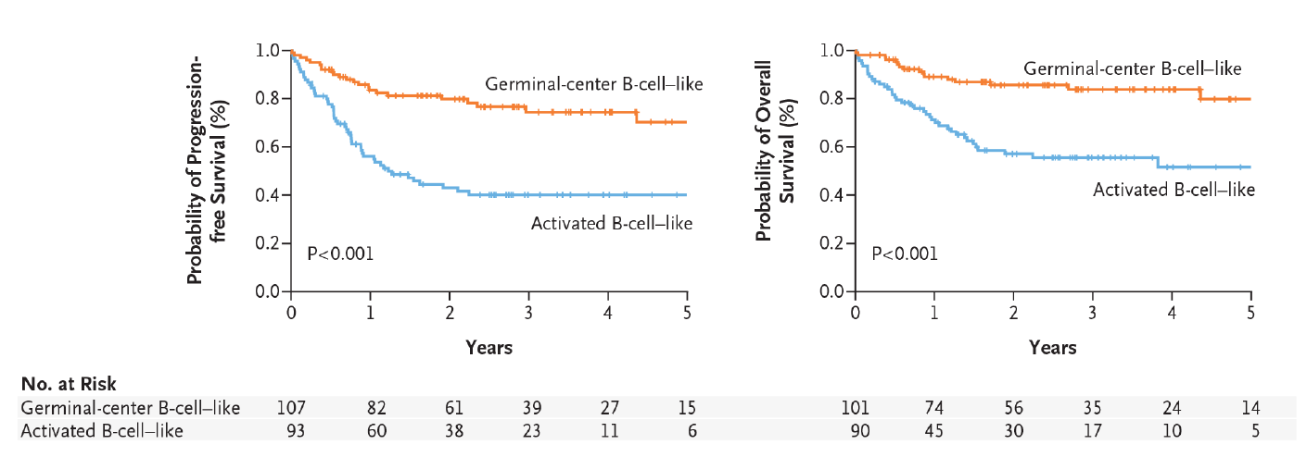
R-CHOP responses vary according to DLBCL molecular subtype Gene expression profiling in pre-treatment biopsy samples from patients treated with 1L R-CHOP (N=233)
R-CHOP is curative in >60% of patients, while the remainder are either refractory to treatment (~10–15%) or relapse after initial CR (~20–25%)¹
Gene expression predictors of survival among patients with DLBCL treated with R-CHOP²
Germinal-center B-cell-like
Germinal-center B-cell-like
PFS (probability)
OS (probability)
Figure to be redrawn
Activated B-cell-like
Activated B-cell-like
P<0.001
P<0.001
Time (years)
Time (years)
R-CHOP is effective in GCB and ABC molecular subtypes, but differences in long-term survival have been observed GCB-DLBCL: ~80% at 5 years; ABC-DLBCL: ~50% at 5 years²

Slide 13
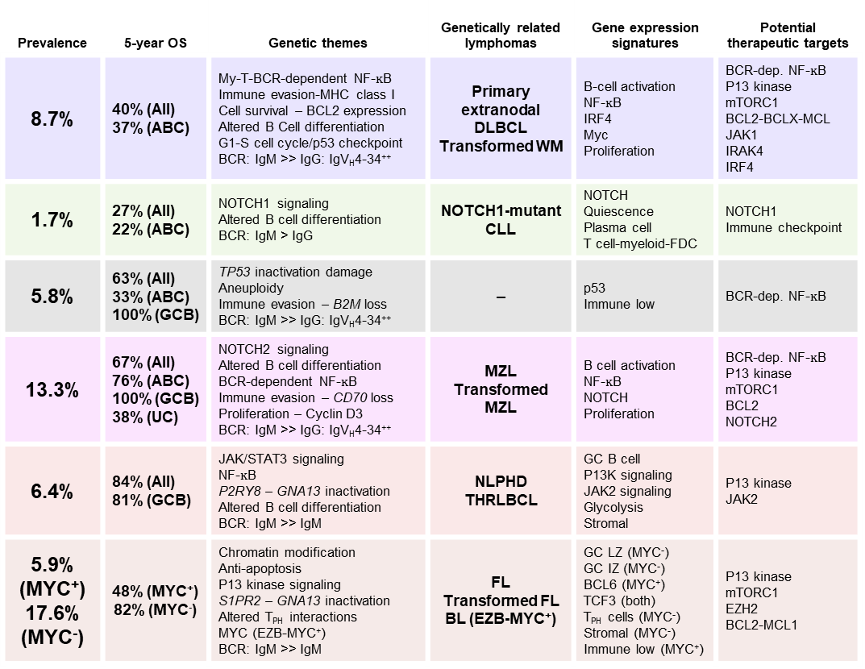
DLBCL subtypes: Implications for pathogenesis and therapy Improvements in our understanding of DLBCL subtypes will support tailored treatment in the future
Prevalence | 5-year OS | Genetic themes | Genetically related lymphomas | Gene expression signatures | Potential therapeutic targets
8.7% | 40% (AII) 37% (ABC) | My-T-BCR-dependent NF-$ĸ\text{B}$ Immune evasion-MHC class I Cell survival – BCL2 expression Altered B Cell differentiation G1-S cell cycle/p53 checkpoint BCR: IgM >> IgG: IgV_{H}4-34⁺⁺ | Primary extranodal DLBCL Transformed WM | B-cell activation NF-$ĸ\text{B}$ IRF4 Myc Proliferation | BCR-dep. NF-$ĸ\text{B}$ P13 kinase mTORC1 BCL2-BCLX-MCL JAK1 IRAK4 IRF4
1.7% | 27% (All) 22% (ABC) | NOTCH1 signaling Altered B cell differentiation BCR: IgM > IgG | NOTCH1-mutant CLL | NOTCH Quiescence Plasma cell T cell-myeloid-FDC | NOTCH1 Immune checkpoint
5.8% | 63% (All) 33% (ABC) 100% (GCB) | TP53 inactivation damage Aneuploidy Immune evasion – B2M loss BCR: IgM >> IgG: IgV_{H}4-34⁺⁺ | – | p53 Immune low | BCR-dep. NF-$ĸ\text{B}$
13.3% | 67% (All) 76% (ABC) 100% (GCB) 38% (UC) | NOTCH2 signaling Altered B cell differentiation BCR-dependent NF-$ĸ\text{B}$ Immune evasion – CD70 loss Proliferation – Cyclin D3 BCR: IgM >> IgG: IgV_{H}4-34⁺⁺ | MZL Transformed MZL | B cell activation NF-$ĸ\text{B}$ NOTCH Proliferation | BCR-dep. NF-$ĸ\text{B}$ P13 kinase mTORC1 BCL2 NOTCH2
6.4% | 84% (All) 81% (GCB) | JAK/STAT3 signaling NF-$ĸ\text{B}$ P2RY8 – GNA13 inactivation Altered B cell differentiation BCR: IgM >> IgM | NLPHD THRLBCL | GC B cell P13K signaling JAK2 signaling Glycolysis Stromal | P13 kinase JAK2
5.9% (MYC⁺) 17.6% (MYC⁻) | 48% (MYC⁺) 82% (MYC⁻) | Chromatin modification Anti-apoptosis P13 kinase signaling S1PR2 – GNA13 inactivation Altered T_{PH} interactions MYC (EZB-MYC⁺) BCR: IgM >> IgM | FL Transformed FL BL (EZB-MYC⁺) | GC LZ (MYC⁻) GC IZ (MYC⁻) BCL6 (MYC⁺) TCF3 (both) T_{PH} cells (MYC⁻) Stromal (MYC⁻) Immune low (MYC⁺) | P13 kinase mTORC1 EZH2 BCL2-MCL1
MCD
N1
ABC
A53
Unclassified
BN2
ST2
GCB
MYC⁺
EZB
MYC⁻

Slide 14
Emerging therapies in 1L DLBCL There is growing need for targeted therapies and individualized treatment decisions
Drug | Key studies | Treatment | Phase | Patient population | Estimated primary completion
Acalabrutinib | ESCALADE¹ | Acala-R-CHOP vs R-CHOP | 3 | Non-GCB DLBCL | August 2026
Tafasitamab | frontMIND² | Tafa + Len + R-CHOP vs R-CHOP | 3 | High-intermediate and high-risk DLBCL | June 2025
Polatuzumab | POLARIX³ | Pola-R-CHP vs R-CHOP | 3 | IPI 2–5 DLBCL | May 2024
Axi-cel | ZUMA-23⁴ | Axi-cel vs R-CHOP or DA-EPOCH-R | 3 | High-risk LBCL | March 2031
Glofitamab | COALITION⁵ | Glofit + pola-R-CHP vs Glofit + R-CHOP | 1b/2 | Higher-risk DLBCL, ≤65 years of age | January 2024
 | NCT04980222⁶ | Glofit + R-CHOP | 2 | High-risk DLBCL (measured by ctDNA) | June 2025
Epcoritamab | EPCORE-DLBCL-3⁷ | Epco vs Epco + Len | 2 | DLBCL | March 2025
 | EPCORE-NHL-2 (Arms 1+8)⁸ | Epco + R-CHOP | 1b/2 | High-risk DLBCL | Complete
 | EPCORE-NHL-5 (Arm 3)⁹ | Epco + anti-neoplastic agents | 1b/2 | DLBCL | May 2029

Slide 15
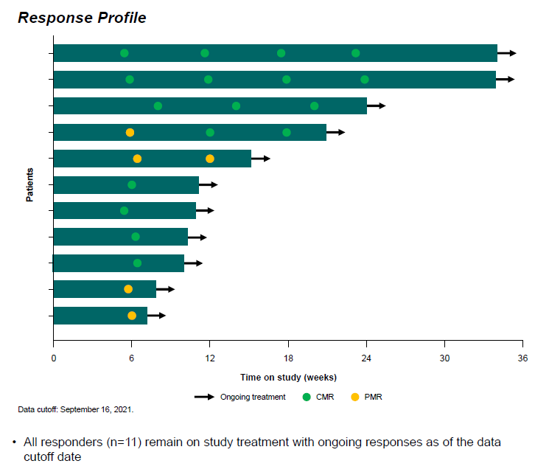
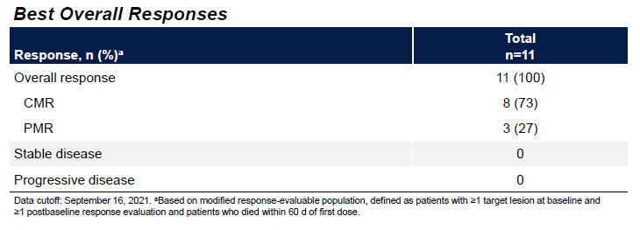
Epcoritamab plus rituximab plus CHOP in 1st line DLBCL
Phase 1b-2
no new safety signals
no treatment delays
no ↑ hematological toxicity
no grade ≥ 3 CRS
No ICANS
Median follow-up 1.3 months

Slide 16
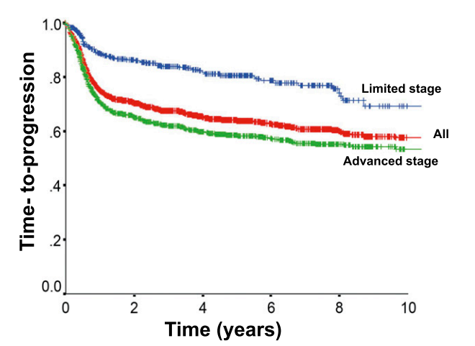
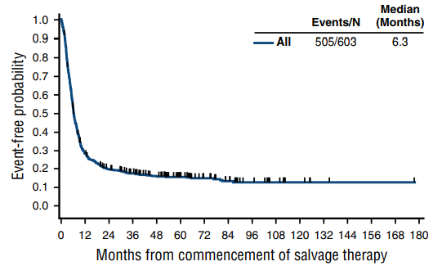
DLBCL: New Therapies are Needed
DLBCL 60% cured; 40% refractory or relapse. Poor outcome rr DLBCL (10% cure)
Molecular heterogeneous: median number genetic driver alterations = 17! (1-48)*
→ targeted therapies disappointing results?
Population based data DLBCL
Scholar 1 rrDLBCL
Sehn LH, et al. Blood 2015
Crump M, et al. Blood 2017
*Chapuy, ASH 2021

Slide 17
WHAT WAS THE MEDIAN OS FOR PATIENTS WITH R/R DLBCL WITH PRIOR STANDARD OF CARE?
SCHOLAR-1: International, multicohort retrospective study evaluating outcomes of patients with R/R DLBCL (N=636)
Patients were primary refractory, refractory to ≥2 lines of therapy or relapsed ≤12 months post ASCT
OS rates from the start of salvage therapies
7%
CR rate
(95% CI: 3–15%)
26 %
ORR
(95% CI: 21-31%)
6.3 months
Median OS
28%
1-year OS rate
20%
2-year OS rate
Highlighted poor survival among patients with R/R DLBCL treated with conventional chemotherapy
 | Prior to new therapies, median OS for patients with R/R DLBCL was 6.3 months
ASCT: allogeneic stem cell transplant; CR: complete response; DLBCL: diffuse large B-cell lymphoma; ORR: objective response rate; OS: overall survival; R/R: relapsed refractory. Crump M, et al. Blood 2017; 130:1800–1808.

Slide 18

Anti-CD19 CAR T-cell therapies in 2L R/R DLBCL Axi-cel and liso-cel are approved in this setting
Therapy | Axicabtagene ciloleucel (axi-cel)^{1,2} | Lisocabtagene maraleucel (liso-cel)¹ | Tisagenlecleucel (tisa-cel)¹
Vector | Gammaretroviral | Lentiviral | Lentiviral
Costimulatory domain | CD28 | 4-1BB | 4-1BB
CD4+ Th: CD8+ CAR T-cell ratio | Not fixed | Administered in a pre-defined fixed ratio | Not fixed
2L R/R studies | ZUMA-7³ (Phase 3) | TRANSFORM⁵ (Phase 3) PILOT⁶ (Phase 2) | BELINDA⁴ (Phase 3)
2L indication | DLBCL refractory to 1L CIT or that relapses within 12 months of 1L CIT^{7,8} | DLBCL refractory to 1L CIT or that relapses within 12 months of 1L CIT^{9,10} DLBCL refractory to, or relapsed after 1L CIT and not eligible for HSCT because of comorbidities or age^{9,10} | N/A

Slide 19
CAR T therapies may transform 2L treatment of DLBCL Efficacy demonstrated in primary refractory, early relapsing, and transplant-ineligible DLBCL subpopulations
Relapsed DLBCL
Primary refractory or relapsed ≤ 12 months
Relapsed > 12 months
2nd line CAR-T (Axi-cel or Liso-cel)
Eligible for Auto-HCT
2nd line CAR-T (Liso-cel)
No
Yes
Relapse
3rd line CAR-T (Axi-cel, Liso-cel, Tisa-cel)
SD or PD
Salvage chemotherapy
AlloSCT Clinical trials Other approved regimens containing: Tafasitamab-cxix Loncastuximab tesirine Polatuzumab vedotin
CR or PR
Relapse
High dose chemotherapy followed by auto-HCT
Relapsed after auto-HCT
There may be a shift in the 2L setting towards classifying patients according to CAR T eligibility in addition to ASCT eligibility

Slide 20
Phase 2 outcomes with liso-cel in patients with R/R LBCL PILOT: Open-label, multi-center study in patients treated with 1 prior LoT not intended for SCT (n=61)
Best response in efficacy analysis patients
AEs of special interest | Liso-cel treated patients (n=61)
CRS (any grade)* Grade 1/2 Grade 3 Grade 4 or 5 Median time to onset,† days (range) Median time to resolution,‡ days (range) | 38% 18% / 18% 2% 0 4 (3–7) 4 (2–5)
NEs (any grade)§ Grade 1/2 Grade 3 Grade 4 or 5 Median time to onset,* days (range) Median time to resolution,† days (range) | 31% 18% / 8% 5% 0 7 (5–12) 6 (3–11)
ORR: 80%
High and durable responses with manageable and consistent safety, despite advanced age and comorbidities in the PILOT population, supported liso-cel as a 2L treatment in transplant-ineligible patients with DLBCL for whom SCT is not intended

Slide 21
Significant clinical benefit of liso-cel over SoC in 2L DLBCL TRANSFORM: ASCT-eligible patients aged ≤75 years with relapsed or primary refractory LBCL (N=184)
EFS by IRC (ITT population)*
Endpoint | Liso-cel (n=92) | SoC† (n=92)
ORR rate CR rate | 87% 73.9% | 48.9% 43.5%
Duration of CR, n with event Median, mo | 21 NR | 21 9.3
PFS, n with event Median, mo | 37 NR | 52 6.2
1.0
0.9
0.8
0.7
0.6
0.5
Population patients without an event
0.4
Liso-cel Median EFS (95% CI): NR (9.5–NR)
0.3
0.2
SOC Median EFS: (95% CI) 2.4 mo (2.2–4.9)
0.1
0.0
Median follow-up: 14.5 months
0
2
4
6
8
10
12
14
16
18
20
22
24
26
28
30
32
34
Time for randomization, months

Slide 22
Significant clinical benefit of liso-cel over SoC in 2L DLBCL TRANSFORM: ASCT-eligible patients aged ≤75 years with relapsed or primary refractory LBCL (N=184)
Treatment-emergent adverse events
Liso-cel (n=92)
SoC* (n=91)
Neutropenia
83%
82%
52%
55%
Anemia
67%
52%
56%
68%
Thrombocytopenia
60%
50%
68%
73%
Nausea
53%
3%
4%
58%
CRS
49%
1%
Headache
43%
4%
1%
23%
Fatigue
40%
2%
41%
Constipation
33%
2%
26%
Pyrexia
30%
25%
Any grade
Grade
≥ 3
Lymphopenia
27%
26%
10%
12%
Diarrhea
25%
3%
43%
Liso-cel
Decreased appetite
23%
1%
4%
35%
SoC*
Vomiting
20%
1%
2%
30%
Febrile neutropenia
16%
12%
23%
26%
100
80
60
40
20
0
20
40
60
80
100
TEAE incidence, %
CAR T-specific AEs were manageable and consistent with previous studies

Slide 23
HRQoL outcomes improved or maintained with 2L liso-cel vs SoC TRANSFORM: ASCT-eligible patients aged ≤75 years with relapsed or primary refractory LBCL (N=90)
Improvement
EORTC QLQ-C30 GHS/QoL
60
SoC (n=43)
Liso-cel (n=47)
50
40
30
20
MID = 10
10
0
Mean (95% CI) change score from baseline
-10
MID = -10
-20
-30
-40
-50
-60
Worsening
Baseline
Day 29-month 1
Day 64
Day 126
Month 6
Visit
Outcomes, including physical functioning, cognition, fatigue, pain, and FACT-LymS, were improved or maintained vs SoC*

Slide 24
Significant efficacy improvement with 2L axi-cel vs SoC ZUMA-7: Pre-planned subgroup analysis of patients aged ≥65 years with R/R DLBCL with prior CIT (N=109)
EFS (by blinded central review)*^{,1}
 | ≥65 years |  |  | All patients
Population | Axi-cel (n=51) |  | SoC† (n=58) | Axi-cel (n=180) | SoC† (n=179)
Median EFS, mo (95% CI) | 21.5 (5.0–NE) |  | 2.5 (1.6–3.2) | 8.3 (4.5–15.8) | 2.0 (1.6–2.8)
24-month EFS rate, % (95% CI) | 47.8 (33.2–61.0) |  | 15.1 (7.1–25.8) | 40.5 (33.2–47.7) | 16.3 (11.1–22.2)
Stratified HR (95% CI)‡ | 0.276 (0.164–0.465) |  |  | 0.398 (0.308–0.514)
ORR CR | 88% 14% | 52% 33% |  | 83% 65% | 50% 32%
100
80
60
EFS (%)
40
20
Median follow-up: 24.3 months
0
0
2
4
6
8
10
12
14
16
18
20
22
24
26
28
30
32
Time (months)
Superior efficacy with axi-cel vs SoC in patients, despite the greater frequency of high-risk features in the axi-cel arm

Slide 25
Manageable and consistent safety profile with 2L axi-cel vs SoC ZUMA-7: Pre-planned subgroup analysis of patients aged ≥65 years with R/R DLBCL with prior CIT (N=109)
Most common adverse events in ≥20% of patients¹
AEs | Axi-cel (n=49) |  | SoC (n=55)
 | Any grade | Grade ≥3 | Any grade | Grade ≥3
Any AE* | 100% | 94% | 100% | 82%
Pyrexia | 96% | 8% | 25% | 0
Neutropenia | 80% | 80% | 44% | 44%
Nausea | 47% | 2% | 67% | 5%
Anemia | 45% | 39% | 58% | 45%
Thrombocytopenia | 43% | 29% | 67% | 64%
Leukopenia | 39% | 37% | 18% | 18%
CRS†,‡ | 98% | 8% | – | –
Pyrexia | 98% | 6% | – | –
Hypotension | 44% | 10% | – | –
Neurologic events† | 65% | 27% | 25% | 2%
High-grade AEs, including CRS and neurologic events, were as expected and consistent with larger analysis²

Slide 26
Clinically meaningful improvement in QoL with 2L axi-cel vs SoC ZUMA-7: Pre-planned subgroup analysis of patients aged ≥65 years with R/R DLBCL with prior CIT (N=109)
EORTC QLQ-C30 PF
EORTC QLQ-C30 GHS/QoL
EQ-5D-5L VAS
20
20
20
*
*
10
*
10
*
10
*
*
0
*
0
0
-10
-10
-10
Estimate, 95% CI
-20
-20
-20
-30
Axi-Cel (n=46)
SOC (n=42)
-30
Axi-Cel (n=46)
SOC (n=42)
-30
Axi-Cel (n=46)
SOC (n=41)
-40
-40
-40
Baseline
Day 50
Day 100
Day 150
Month 9
Month 12
Month 15
Baseline
Day 50
Day 100
Day 150
Month 9
Month 12
Month 15
Baseline
Day 50
Day 100
Day 150
Month 9
Month 12
Month 15
Study visit
Study visit
Study visit
Axi-cel-treated patients showed faster recovery to pre-treatment QoL, indicating satisfactory symptom resolution from the patient’s perspective;¹ outcomes consistent with overall patient population analysis in ZUMA-7²

Slide 27
Axi-cel as 2L therapy for DLBCL in transplant-ineligible patients ALYCANTE: Primary analysis of a prospective, open label, multi-center phase 2 LYSA study (N=40)
Characteristic | Axi-cel (n=40)
Sex male, n (%) | 28 (70.0)
Age, years, median (range) | 68 (49–81)
Age, n (%) ≥65 years ≥70 years | 33 (82.5) 18 (45.0)
Prior autologous transplant, n (%) | 2 (5.0)
ECOG PS 0–1 at inclusion, n (%) | 40 (100.0)
IPI, n (%) 0–1 ≥2 | 3 (7.5) 37 (92.5)
Ann Arbor stage, n (%) I–II III–IV | 9 (22.5) 31 (77.5)
Characteristic | Axi-cel (n=40)
Relapsed or refractory, n (%) Refractory Relapsed ≤ 12 months | 21 (52.5) 19 (47.5)*
Bridging therapy, n (%) Corticosteroids R-GEMOX | 37 (92.5) 0 (0) 37 (92.5)
Response to bridging therapy, n (%) Complete metabolic response Partial metabolic response No metabolic response/stable disease Progressive metabolic disease Not evaluated | 4 (10.0) 8 (20.0) 12 (30.0) 15 (37.5) 1 (2.5)

Slide 28
Deep responses and improved survival after 2L axi-cel infusion ALYCANTE: Primary analysis of a prospective, open-label, multi-center phase 2 LYSA study (N=40)
Best response*
PFS from infusion
EFS from leukapheresis
ORR: 92.5%
PMD
1.0
Censored
95% confidence limits
1.0
Censored
95% confidence limits
PMR
CMR
0.8
0.8
0.6
0.6
Response rate (%)
Survival (probability)
Survival (probability)
0.4
0.4
0.2
0.2
n=40
Median PFS: 11 months
6-month PFS: 64.3% (47.2–77.1)
n=44
Median EFS: 10.3 months
6-month PFS: 68.2% (52.3–79.8)
0.0
0.0
40
38
31
24
18
11
5
0
44
40
35
30
19
16
11
0
0
2
4
6
8
10
12
14
0
2
4
6
8
10
12
14
PFS (months)
EFS from leukapheresis (months)
CMR at 3 months post infusion was 70% (95% CI=53.5–83.4); preliminary results indicate that early clearance of ctDNA at day 14 post infusion was highly predictive of CMR at 3 months

Slide 29
Acceptable safety with axi-cel in transplant-ineligible patients ALYCANTE: Primary analysis of a prospective, open-label, multi-center phase 2 LYSA study (N=40)
Adverse events*
All AEs
CRS
Blood electrolyte decreased
Anemia
ICANS
Neutropenia
Thrombocytopenia
COVID-19
Leukopenia
Urinary tract infection
Lymphopenia
Sepsis
Respiratory tract infection
Nausea
Skin infection
Grade ≥3
All grade
0
5
10
15
20
25
30
35
40
45
50
55
60
65
70
75
80
85
90
95
100
Frequency (%)
Grade ≥3 AEs reported in 82.5% of patients; Grade ≥3 CRS and ICANS occurred in 10% and 20% of patients, respectively. At data cutoff, 7 patients had died: 2 as a result of lymphoma, and 5 as a result of fatal AEs (infections)

Slide 30
Real-world improvements in PROs among axi-cel recipients Prospective, single-center study utilizing EORTC QLQ-C30 assessment of QoL and symptomology (N=53)
GHS
Physical functioning
90
90
80
80
70
70
60
60
50
50
40
40
30
30
20
20
10
10
0
0
Baseline
180
360
Baseline
180
360
EORTC-QLQ-C30 domain score (higher = better)
Days after infusion
Days after infusion
Role functioning
Social functioning
90
90
80
80
70
70
60
60
50
50
40
40
General population
30
30
Cancer cohort
20
20
10
10
0
0
Baseline
180
360
Baseline
180
360
Days after infusion
Days after infusion
QoL improved and symptom severity reduced after axi-cel infusion from baseline to 360 days, including fatigue, insomnia, and appetite loss

Slide 31
Causes and risk factors of early/late NRM after CAR T in DLBCL A Lysa study from the Descar-T Registry between June 2018 and April 2022 (N=957)
Causes of death in NRM populations
Risk factors for overall NRM (univariate analysis)*
 |  | All NRM (N=58) | Comparative group (N=191) | P value
Patient characteristics | Age, median | 67 | 63 | 0.003
 | Diabetes | 23.4% | 10.1% | 0.025
At lymphodepletion | ECOG PS ≥2 | 22.7% | 4.9% | <0.001
 | Hemoglobin, g/dL, median | 9.6 | 10.7 | 0.002
 | Platelets, G/L, median | 156 | 185 | 0.034
 | C reactive protein, mg/L, median | 17 | 5 | <0.001
 | Ferritin, μg/L, median | 732 | 393 | 0.002
 | Hypogammaglobulinemia | 54.8% | 48% | 0.556
Post-infusion | CRS ≥ grade 3 | 27.1% | 5.2% | <0.001
 | ICANS ≥ grade 3 | 31.3% | 10.5% | <0.001
 | Neutrophil count grade 4 at M1 | 23.5% | 10.5% | 0.047
 | Platelets count grade 4 at M1 | 28.2% | 12.3% | 0.024
 | Hemoglobin, g /dL at M1, median | 9.7 | 10.8 | 0.001
 | Platelets count grade 4 at M3 | 12% | 2.2% | 0.039
CAR T product | Tisa-cel / Axi-cel | 35.4% / 64.6% | 27.2% / 72.8% | 0.287
Pre-existing score | CAR-hematotox score (1) Low / High | 41.7% / 58.3% | 71.2% / 28.8% | <0.001
Patients (%)
NRM is associated with CD19 CAR T-cell therapy and is a rare event that usually occurs beyond day 28 (80% cases); outcomes with CAR T may be improved by reducing NRM
Notes:
NRM: MORTALIDAD NO RECAÍDA
Immune effector cell-Associated Neurotoxicity Syndrome (ICANS)

Slide 32
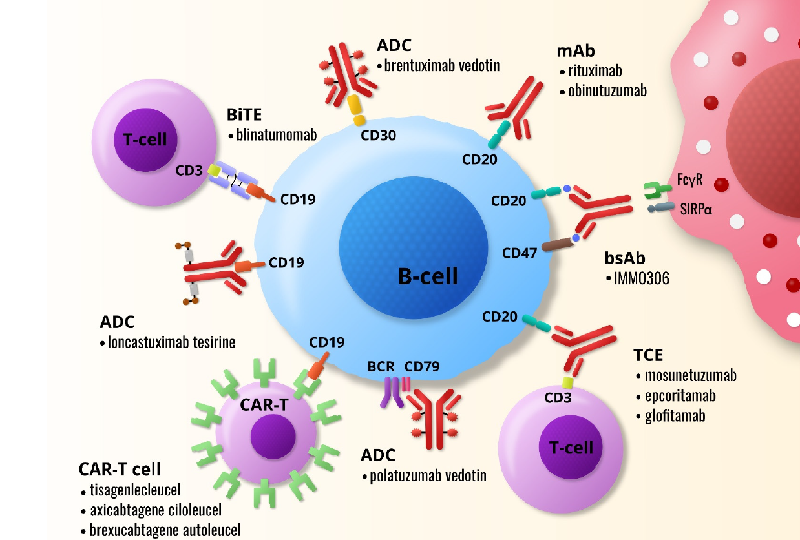
Immunotherapeutic Modalities B-NHL
Mihalyova J, et al. Int J Mol Sci 2021

Slide 33
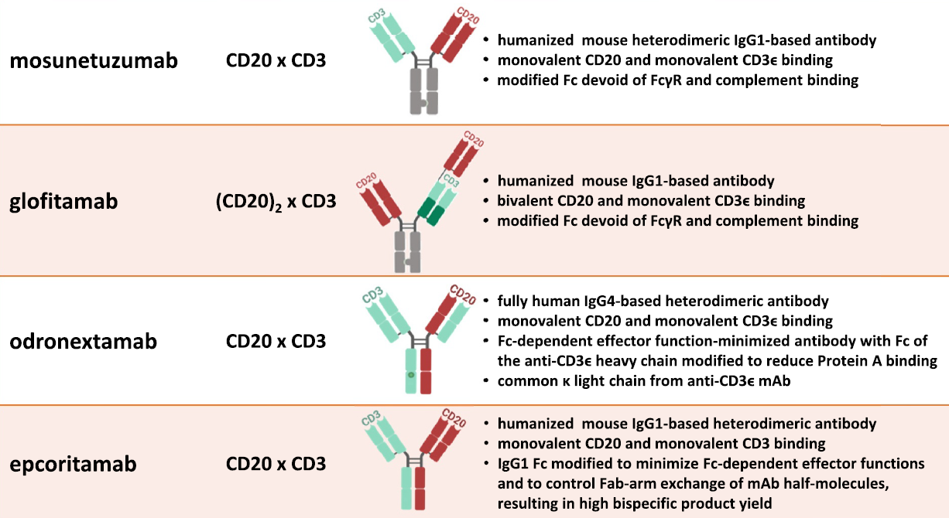
Current CD3 x CD20 Bispecifics in Development
Schuster SJ. Hematol Oncol 2021

Slide 34
Deep and durable responses with Epco + R-DHAX in R/R DLBCL EPCORE NHL-2 arm 4: High-risk and highly refractory ASCT-eligible patients with DLBCL (N=27)
Response rates in both transplanted and non-transplanted patients*
*
*
Non-transplanted patients
Ongoing treatment
Proceeded to transplant
CMR PMR SD PD
Date of transplant
Discontinued due to PD
Prior CAR T
Transplanted patients
*
0
6
12
18
24
30
36
42
48
54
60
66
n=23
Time on treatment (weeks)
Manageable safety with no unexpected findings observed with Epco + R-DHAX; no fatal TEAEs or clinical TLS events. CRS was low grade with all events resolved

Slide 35
High response rates with PolaR-ICE in R/R DLBCL Phase 2 cohort 2-stage study (N=41)
N=22 (61%)
N=16
N=22 (54%)
Stem cell
mobilization
ASCT
Pola
consolidation
× 3–4 C
CR
N=8
N=41
N=38
N=14 (34%)
N=23
PolaR-ICE
× 2 C
PR
PolaR-ICE
× 1 C
CR
PR
N=14
CT/PET
scan
N=1
SD
PD
SD
N=16 no ASCT
N=3 no PET
1 death after C1
1 pt withdrawal after C1
1 clinical PD after C2
Off
trial
N=1
PD
Response at end of salvage (all-treated): ORR 80%, CR 56%
Response after 2 C (all-treated): ORR 88%, CR 54%
Responses were deep and durable, both after 2 C and at end of salvage, and were consistent in both primary refractory and relapsed patient subgroups; longer follow-up needed to adequately assess impact on survival outcomes

Slide 36

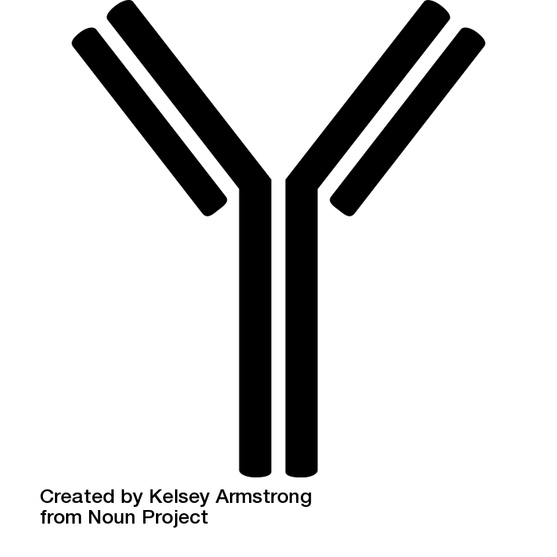
Lymphoma: Where are we now? Current immune-based antibody and cellular therapies in NHL
Recombinant human IL15
Macrophage
Lenalidomide
Tafasitamab
CAR T lymphocyte
MHC II w Tu peptide
NK-cell
CAR
FcyR
mAb
Anti-4-1BB
Lymphoma cell
mAb
4-1BB
Complement
CD16A
Bispecific antibodies
Tu
antigen
PD-L1
Anti-PD-L1
CD79B
MHC I w Tu peptide
Anti-PD-1
Antigen presentation
4-1BB
PD-1
TCR
TCR
Anti-4-1BB
Cytolytic synapse
CD4⁺
T lymphocyte
bsAb
CD8⁺
T lymphocyte
MHC II w Tu peptide
ADCs:
Polatuzumab
Loncastuximab
TRPH-222
VLS-101
Anti-CD20 monoclonal antibodies
Dendritic cell

Slide 37
High response rates with long-term tafasitamab in R/R DLBCL L-MIND: Multi-center, open-label, single-arm, phase 2 study in patients ineligible for auto-SCT (N=81)
ID-27
ID-26
ID-25
ID-24
ID-23
ID-22
ID-21
ID-20
ID-19
ID-18
ID-17
ID-16
ID-15
ID-14
Survival follow-up
On treatment
ID-13
ID-12
ID-11
ID-10
ID-9
ID-8
ID-7
ID-6
ID-5
ID-4
ID-3
ID-2
ID-1
0
12
24
36
48
60
Best response
Symbol legend:
Time under treatment (solid bars) and survival in months
CR
PR
Primary refractory
Refractory to last line
NALT
CR (first)
PR first
PD
Loss survival follow-up
Death
CR was achieved by 23/27 patients; 4 patients achieved PR, of which 2 were still on treatment. Tafa was well tolerated and resulted in prolonged remission and survival of ≥5 year

Slide 38
How should we treat patients who relapse on CAR T therapy? New treatment algorithms are needed to optimize outcomes with novel therapies in the post-CAR T setting
Proposed algorithm for post-CAR T treatment selection in R/R DLBCL
R/R DLBCL after CAR T-cell therapy
Risk factors for relapse after CAR T
High CIBMTR prognostic score, ECOG PS ≥2;
Stage III/IV disease, extranodal sites ≥2;
Elevated LDH, C-reactive protein;
High IPI, total metabolic tumor volume
Consider biopsy to assess CD19 status*
CD19 status: Positive
CD19 status: Negative; not assessed
Polatuzumab vedotin + rituximab ± bendamustine
Loncastuximab
Tafasitamab + lenalidomide
Selinexor
CD20-CD3 Bi-Ab
CD19/non-CD19 CAR T
XRT (limited site, palliative)
Polatuzumab vedotin + rituximab ± bendamustine
Selinexor
CD20-CD3 Bi-Ab
Non-CD19 CAR T
XRT (limited site, palliative)
Consolidative alloHCT: Fit patient, disease in CR
Patients who relapse on CAR T therapy have poor prognosis and survival outcomes; novel therapies may offer the best chance of improving outcomes for these patients

Slide 39
Outcomes of patients with aNHL after anti-CD19 CAR T failure DESCAR-T analyses highlight poor outcomes and limited treatment options following CAR T (N=238)
Baseline characteristics, n (%) | All patients (N=238)
Aged ≥65 years | 91 (38.2)
Male | 160 (67.2)
>3 prior LoT Prior auto-SCT | 136 (57.1) 46 (19.3)
ECOG PS ≥2 | 28 (12.2)
Bulky disease (>5 cm) | 53 (38.7)
CAR T product used
Axi-cel | 136 (57.1)
Tisa-cel | 102 (42.9)
Select treatments administered after CAR T | Evaluable patients (n=154)*
Lenalidomide | 59 (38.3)
anti-CD20-CD3 bsAbs | 11 (7.1)
Targeted therapies† | 33 (21.4)
Immunochemotherapy | 31 (20.1)

Slide 40
Outcomes of patients with aNHL after anti-CD19 CAR T failure DESCAR-T analyses highlight poor outcomes and limited treatment options following CAR T (N=238)
Outcomes after CAR T relapse according to treatment type (median follow-up: 7.9 months)
 | bsAbs | RT | CIT | TT | Len
Median PFS | 3.7 mo | 3.7 mo | 2.4 mo | 2.1 mo | 3.8 mo
Median OS | 8.5 mo | 9.6 mo | 3.7 mo | 4.5 mo | 7.5 mo
Patients (%)
ORR: 35.7%
ORR: 14.3%
ORR: 11.5%
ORR: 11.1%
ORR: 8%
Radiotherapy (n=17)*
Targeted therapy (n=33)†
Limited activity with anti-CD20-CD3 bsAbs in patients following CAR T progression/relapse; data indicate salvage immunomodulatory treatment (i.e. Len) may offer better outcomes compared with standard chemoimmunotherapy

Slide 41
Novel therapies may improve outcomes after relapse on CAR T Retrospective, multi-center analysis of salvage therapy in patients with DLBCL (N=217)
Best response to first salvage treatment after CAR T
ORR: 62%
ORR: 48%
ORR: 32%
ORR: 27%
Patients (%)
Patients progressing early after CAR Ts have poor survival outcomes; Pola- and bsAb-based therapies yield higher response rates than standard chemotherapy in these patients

Slide 42
Best PFS and OS with bsAbs 3 months post-CAR T in R/R DLBCL A Lysa study from the DESCAR-T registry in patients registered from July 2018 onwards (N=977)
PFS since first progression after CAR T therapy according to type of treatment*
1.0
1: Anti-PD1 (n=7)
0.8
2: Bispecific (n=18)
3: Chemotherapy (n=22)
0.6
4: Lenalidomide (n=41)
5: Targeted drug (n=16)
0.4
Survival probability
0.2
0.0
1
7
2
0
2
18
9
2
0
3
22
4
2
1
1
1
0
4
41
12
5
3
1
1
0
5
16
4
1
0
0
6
12
18
24
30
36
Time (months)
Compared to chemotherapy (6-month PFS and OS of 22% and 39.4%, respectively), only bsAb treatment resulted in a 6-month PFS benefit (77.5%), while 6-month OS was longer in both the targeted therapy (76.6%) and bsAb groups (92.9%)

Slide 43
Deep responses and manageable safety with Epco in R/R DLBCL EPCORE NHL-1 (dose expansion): Open-label, phase 1/2 study in highly refractory patients (N=157)
Response rates (by IRC)
Characteristic | Epcoritamab (N=157)
Median age, years (range) Median prior LoT, n (range) Median follow-up, months | 64 (20–83) 3 (2–11) 10.7
100
*
*
*
*
*
*
*
*
*
*
CMR PMR SD PD Prior CAR T cell
75
*
*
*
*
*
*
TRAEs of special interest†
Any grade CRS Grade 3 CRS | 49.7% 2.5%
Any grade ICANS Grade ≥3 ICANS | 6.4% 0.6%‡
TLS | 1.3%
Other common events
Neutropenia Anemia Thrombocytopenia | 21.7% 17.8% 13.4%
SAEs
Serious TRAEs | 35%
TRAE leading to Epco discontinuation | 7.6%
*
50
*
25
*
*
*
*
Best change from baseline in tumor size (%)
0
-25
-50
*
*
*
*
-75
*
*
*
*
*
*
*
*
*
*
*
-100
Median DOR: 12 months
*
*
*
*
*
*
*
*
*
*
*
*
*
*
*
*
Patients
*
*
*
*

Slide 44
Epco monotherapy leads to deep, durable responses and uMRD EPCORE NHL-1 (dose expansion): Novel subgroup analyses in highly refractory patients with LBCL (N=157)
Response and uMRD rates with Epco across patient subgroups, including patients with prior CAR T
ORR: 69%†
ORR: 63%*
ORR: 55%†
ORR: 54%†
ORR: 46%†
Patients (%)
uMRD rate: 45%*
uMRD rate: 40%*
uMRD rate: 45%*
uMRD rate: 47%*
uMRD rate: 40%*
An estimated 61% and 55% of responders remained in response at 9 and 12 months, respectively; an estimated 89% and 79% of complete responders remained in response at 9 and 12 months, respectively

Slide 45
Response correlated with robust survival and manageable safety EPCORE NHL-1 (dose expansion): Novel subgroup analyses in highly refractory patients with LBCL (N=157)
Improvements in PFS correlate with uMRD¹
Trends show decrease in rate of TEAEs over time¹
100
100
90
Total TEAEs
Total G3+ TEAEs
Neutropenia (G3–4)
Anemia (G3)
Thrombocytopenia (G3–4)
CRS (G3)
80
80
70
60
60
DH/TH and MRD negative (n=4)
Non-DH/TH and MRD negative (n=36)
CAR T-exposed and MRD negative (n=21)
CAR T-naïve and MRD negative (n=33)
Primary refractory and MRD negative (n=29)
Non-primary refractory and MRD negative (n=25)
Overall MRD positive (n=65)
50
Probability of PFS (%)
Patients (%)
40
40
30
20
20
10
0
0
0
3
6
9
12
15
18
Weeks ≤12 QW dosing (N=157)
Weeks >12 to ≤36 Q2W dosing (n=99)
Weeks >36 Q4W dosing (n=49)
Time (months)
Median OS was NR in the overall population; however, patients who achieved a CR had robust survival;¹ a separate PRO analysis demonstrated that SC epcoritamab improved symptoms and overall QoL²

Slide 46
Deep responses and manageable safety with Glofit in R/R DLBCL Phase 2 part of a phase 1/2 study of heavily pretreated and highly refractory patients (N=155)
Response rates*
Characteristic | Glofitamab (n=154)‡
Median age, years (range) Median prior LoT, n (range) Median follow-up, months | 66 (21–90) 3 (2–7) 12.6
Endpoint | Glofit
Median PFS, mo (95% CI)* Median OS, mo (95% CI)† Median DoR, mo | 4.9 (3.4–8.1) 11.5 (7.9–15.7) 18.4
TRAEs of special interest*
Any grade CRS Grade ≥2 CRS | 66%§ 18%§
Any grade ICANS Grade ≥3 ICANS | 8% 0.6%
TLS | 1%║
Other common events
Neutropenia Anemia Thrombocytopenia | 38% 31% 25%
SAEs | 47%
TRAE leading to Glofit discontinuation | 3%

Slide 47
Promising initial outcomes with Epco + GemOx in R/R DLBCL EPCORE NHL-2 arm 5: High-risk and highly refractory ASCT-ineligible patients (N=25)
Response rates*
Most common TEAEs | Epco + GemOx (N=25)
CRS† ICANS‡ TLS‡ | 70% 4% 4%
Thrombocytopenia Neutropenia Anemia Infections | 70% 56% 52% 52%
Grade 5 AEs§ Fatal AEs║ | 22% 16%
ORR: 92%
PMR
CMR
Response rate (%)
65% responders remained in response at data cutoff with longest DoR 6.9 months; 3 patients with prior CAR T remained on treatment and in response (2 CMR and 1 PMR). Safety was manageable with no unexpected findings observed with Epco + GemOx in this patient population with high unmet need

Slide 48
Poor outcomes with CD19 immunomodulators post CAR T Limited activity and infrequent responses with Tafa-Len emphasize an unmet need in relapsed DLBCL
Tafa-Len in patients with R/R DLBCL treated with prior CAR T (n=42)*^{,1}
OS and PFS with Tafa-Len or Lonca post CAR T relapse (N=41)^{†,2}
100
N
Events
Median survival (95% CI)
OS
41
26
18.6 (14.1–NA)
PFS
41
36
8.0 (5.0–13.0)
75
Response rate (%)
Survival (%)
50
ORR: 36%
25
ORR: 7%
0
0
4
8
12
16
20
24
28
32
Time from initiation of Tafa or Lonca (weeks)

Slide 49
Lymphoma: Where are we heading? Ongoing studies and anticipated approvals for CD20×CD3 bispecific antibodies
Mosunetuzumab + lenalidomide
Phase 1 R/R FL
NCT04246086 (est. completion Mar 2026)
Glofitamab + GemOx
Phase 1/3 R/R DLBCL
NCT04408638 (est. completion Apr 2025)
Recombinant human IL15
Macrophage
Lenalidomide
CAR T lymphocyte
NK cell
MHC II w Tu peptide
Glofitamab + Obin pre-treatment
Phase 1 R/R FL
NCT03075696 (est. completion Aug 2025)
Epcoritamab + SoC*
Phase 1b/2 ND or R/R DLBCL, ND or R/R FL
NCT04663347 (est. completion Nov 2024)
CAR
mAb
FcyR
Anti-4-1BB
Lymphoma cell
mAb
4-1BB
Complement
CD16A
Tu
antigen
PD-L1
Anti-PD-L1
bsAb
MHC I w Tu peptide
4-1BB
CD79B
PD-1
Anti-PD-1
Antigen presentation
Anti-4-1BB
TCR
Cytolytic synapse
TCR
Glofitamab + multiple combinations
Phase 1 R/R B-NHL NCT03075696 (est. completion Aug 2025)
Phase 1 ND DLBCL and R/R B-NHL NCT03467373 (est. completion Dec 2023)
CD4⁺
T lymphocyte
bsAb
CD8⁺
T lymphocyte
MHC II w Tu peptide
Epcoritamab vs investigator’s choice chemotherapy (BR or R-GemOx)
Phase 3 R/R DLBCL
NCT04628494 (est. completion May 2024)
Dendritic cell
Notes:
Abbreviations: ASCT, autologous stem cell transplant; B, bendamustine; B-NHL, B-cell non-Hodgkin lymphoma; bsAb, bispecific antibody; CAR, chimeric antigen receptor; CHOP, cyclophosphamide, doxorubicin, vincristine, prednisone; DHAX/C, cisplatin, cytarabine, and dexamethasone; FcγR, receptor for constant fragment (Fc) of immunoglobulin gamma; GemOx, gemcitabine and oxaliplatin; mAb, monoclonal antibody; MHC, major histocompatibility complex; ND, newly diagnosed; NK, natural killer; obi, obinutuzumab; PD-1, programmed cell death 1; PD-L1, PD-1 ligand 1; R, rituximab; SoC, standard of care; TCR, T-cell receptor; Tu, tumor.

Slide 50
Lymphoma: Where are we heading? Ongoing studies and anticipated approvals for CD20×CD3 bispecific antibodies plus other novel agents
Mosunetuzumab + polatuzumab vedotin
Phase 1b/2 R/R DLBCL and R/R FL
NCT03671018 (est. completion Jul 2025)
Phase 3 R/R aB-NHL
NCT05171647 (est. completion Mar 2026)
Glofitamab + RO7227166 with obinutuzumab pre-treatment
Phase 1 R/R B-NHL
NCT04077723 (est. completion Mar 2025)
Mosunetuzumab + lenalidomide
Phase 3 R/R FL NCT04712097 (est. completion May 2029)
Recombinant human IL15
Macrophage
Lenalidomide
CAR T lymphocyte
NK cell
MHC II w Tu peptide
CAR
mAb
FcyR
Monsunetuzumab ± atezolizumab
Phase 1/2 R/R B-NHL and CLL
NCT02500407 (est. completion Nov 2023)
Glofitamab + (atezolizumab or polatuzumab vedotin)
Phase 1 R/R B-NHL
NCT03533283 (est. completion Nov 2024)
Lymphoma cell
Anti-4-1BB
mAb
4-1BB
Complement
CD16A
Tu
antigen
PD-L1
Anti-PD-L1
bsAb
MHC I w Tu peptide
CD79B
Anti-PD-1
Antigen presentation
4-1BB
PD-1
Mosunetuzumab + polatuzumab vedotin + CHP
ND DLBCL, R/R B-NHL
NCT03677141 (est. completion Nov 2023)
Anti-4-1BB
TCR
TCR
Cytolytic synapse
TCR
CD4⁺ T lymphocyte
bsAb
CD8⁺
T lymphocyte
MHC II w Tu peptide
Polatuzumab vedotin + R-GEMOX
Phase 3 R/R DLBCL NCT04182204 (est. completion Dec 2025)
Epcoritamab + R²
Phase 1b/2 R/R FL
NCT04663347 (est. completion Nov 2024)
Dendritic cell
Notes:
Abbreviations: ASCT, autologous stem cell transplant; B, bendamustine; B-NHL, B-cell non-Hodgkin lymphoma; bsAb, bispecific antibody; CAR, chimeric antigen receptor; CHOP, cyclophosphamide, doxorubicin, vincristine, prednisone; DHAX/C, cisplatin, cytarabine, and dexamethasone; FcγR, receptor for constant fragment (Fc) of immunoglobulin gamma; GemOx, gemcitabine and oxaliplatin; mAb, monoclonal antibody; MHC, major histocompatibility complex; ND, newly diagnosed; NK, natural killer; obi, obinutuzumab; PD-1, programmed cell death 1; PD-L1, PD-1 ligand 1; R, rituximab; SoC, standard of care; TCR, T-cell receptor; Tu, tumor.

Slide 51
MUCHAS GRACIAS
Email: henryidroboquintero83@gmail.com.
Cel: (+57) 3004957993.
www.grupogell.com

